Slide 1
Pipelining
UNIT 6

Slide 2
Parallel processing
Large class of technique that are used to provide simultaneously Data processing task
Increases computational speed of computer system
Not sequence, process parallel way

Slide 3
Example of parallel processing
Instruction is fetch from memory while other instruction is being executed
Computer can have sometime 2 or more ALU so multiple instruction can be executed
Two or more processor operating concurrently

Slide 4
Advantages and disadvantages of parallel processing
Speed up processing
Increase throughput
Increase hardware, So cost increases

Slide 5
Level of complexity
Lowest level
Parallel and serial operations are distinguish by register used
Shift register operate in serial fashion one bit at a time.
Register with parallel load operate at same time
Highest Level
Having multiple functional unit that perform identical or different operation
Parallel processing is achieved by distributing the Data among various unit.

Slide 6
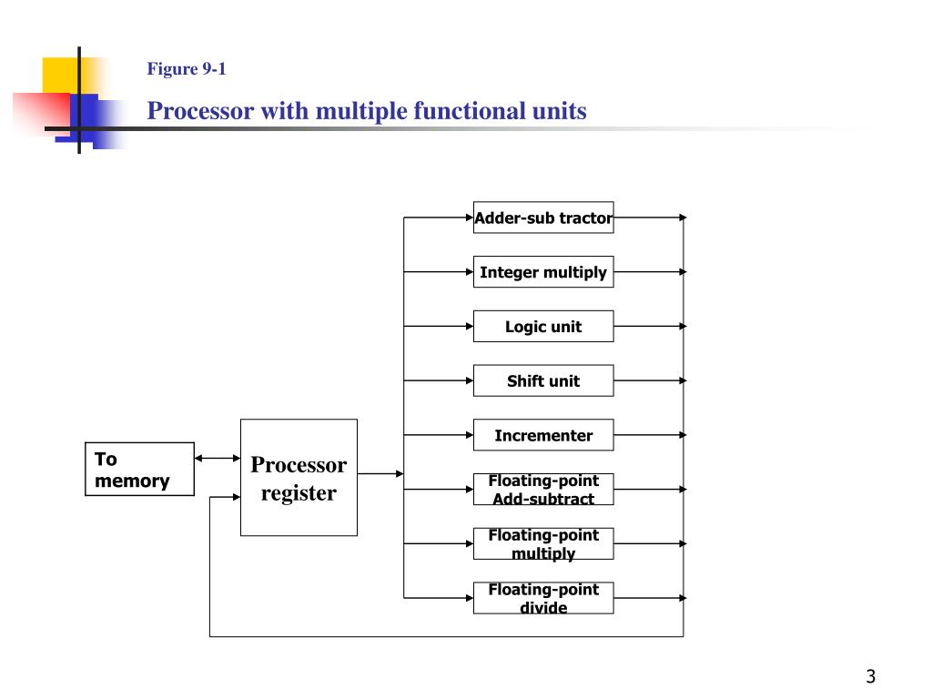

Slide 7
Classification of parallel processing
Flynn’s classification
consider organization of computer system on basis of number of instruction and data items
Single instruction stream, single data stream(SISD)
Single instruction stream, Multiple data stream(SIMD)
Multiple instruction stream, single data stream(MISD)
Multiple instruction stream, Multiple data stream(MIMD)

Slide 8
SISD
Organization of single computer
Contains Control Unit, processor unit and memory
Parallel processing can be achieved via multiple units

Slide 9
SIMD
Contains many processor unit under single control units
All processor get same instruction from control unit and works on different data
Communication between processor are done through shared memory

Slide 10
MISD
Only theoretical interest but no practical system till today

Slide 11
MIMD
Refers to a computer system capable of processing several program at same time
E.g Multiprocessor and multicomputer system

Slide 12
Pipelining processing
Vector processing
Array processing

Slide 13
Pipelining
“Technique of decomposition of sequential process into sub-process with each sub-process being executed in a special dedicated segment that operate concurrently with all other segment.”
Collection of processing segment through which the information flow.
Each segment perform partial processing, where result is transferred to next segment.

Slide 14
Final result is obtained after data is passed through all segments.

Slide 15
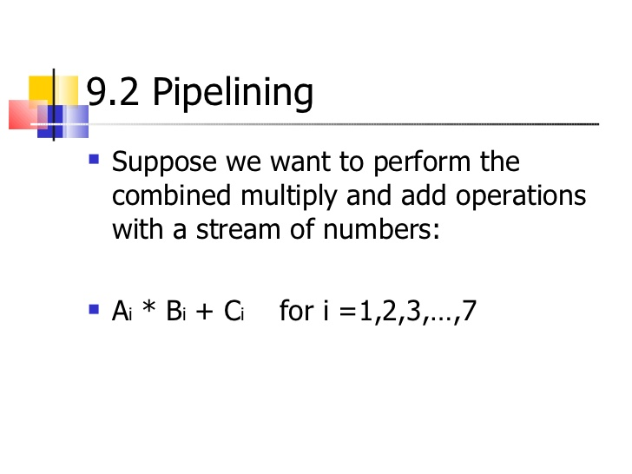
Example of pipelining

Slide 16
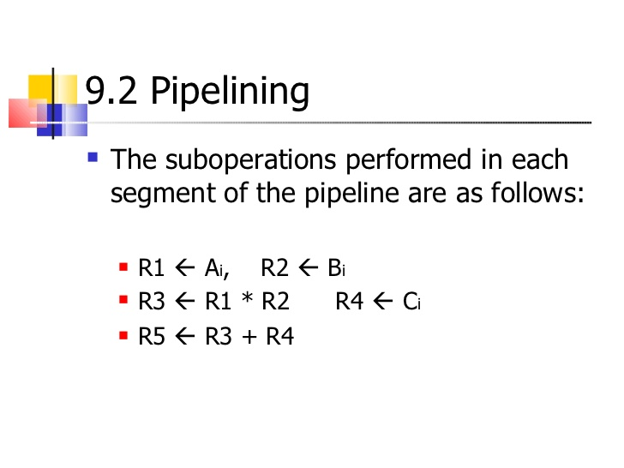

Slide 17
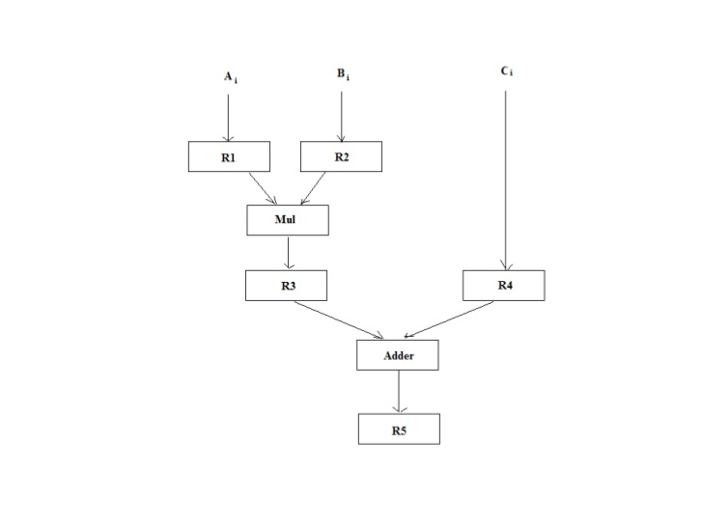

Slide 18
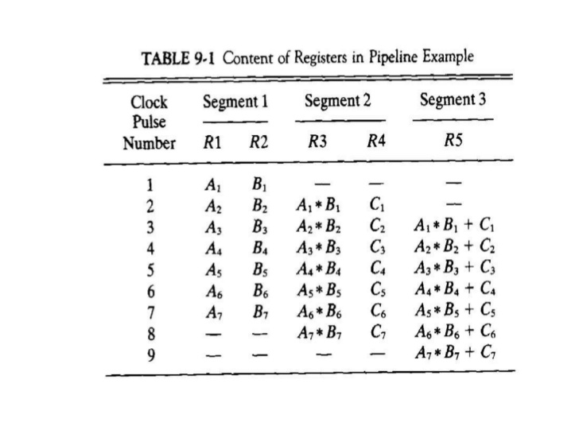

Slide 19
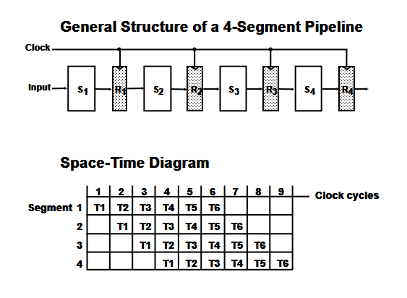
Four segment pipeline

Slide 20
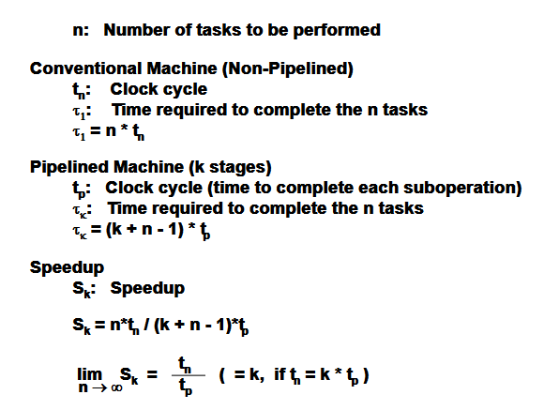
Speedup Equation

Slide 21
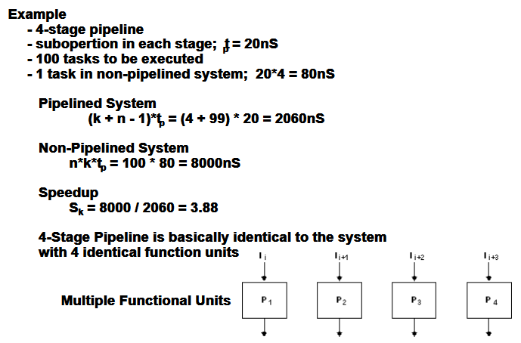

Slide 22
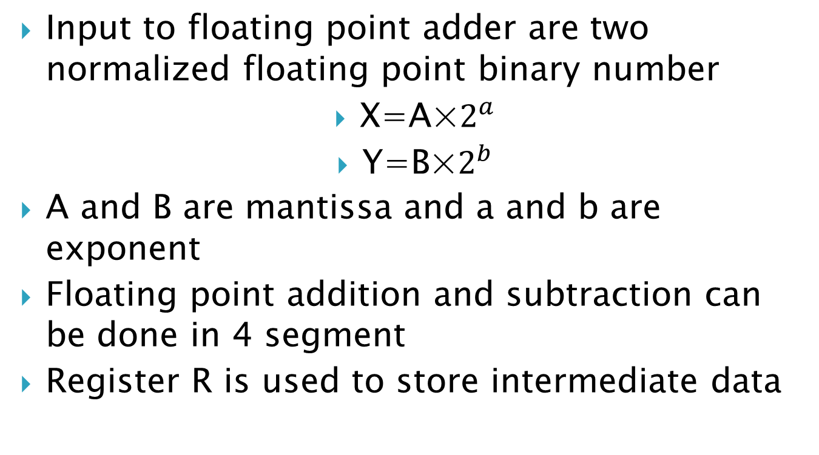
Floating Point Adder and Subtractor
Input to floating point adder are two normalized floating point binary number
X=A×$2^{a}$
Y=B×$2^{b}$
A and B are mantissa and a and b are exponent
Floating point addition and subtraction can be done in 4 segment
Register R is used to store intermediate data

Slide 23
Sub-operation of floating point addition and subtraction
Compare the exponent
By subtracting them to find difference
Larger exponent is chosen as exponent of result
Align the mantissa
Exponent difference determine how many time the mantissa associated with smaller exponent must be shifted right
Add or subtract mantissa
The two mantissa are added or subtracted in segment 3
Normalize result
When overflow occurs the sum or difference is shifted right and exponent is incremented by one.

Slide 24
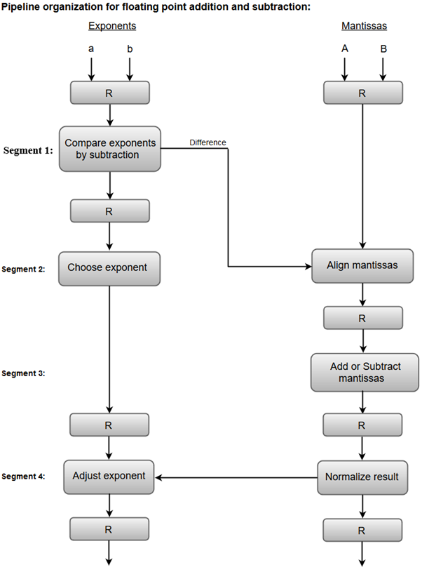

Slide 25

Example

Slide 26
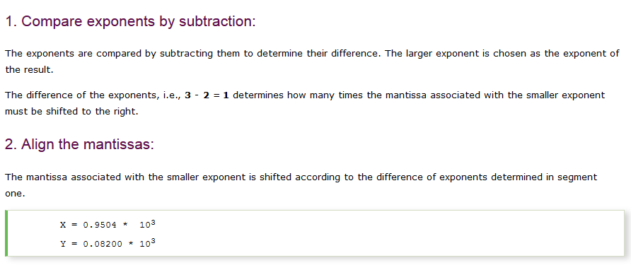

Slide 27
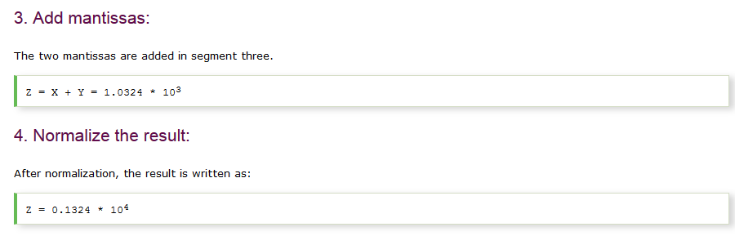

Slide 28
Instruction pipeline
Pipeline processing can occur not only in the data stream but in the instruction stream as well.
Consider fetch unit and execution unit, whenever execution unit is not using memory, the control increments the PC and uses its address to fetch the instruction and insert in FIFO buffer so that they can be executed in FIFO manner.
Most of the digital computers with complex instructions require instruction pipeline to carry out operations like fetch, decode and execute instructions.

Slide 29
Sequence of steps for processing instruction
Fetch instruction from memory.
Decode the instruction.
Calculate the effective address.
Fetch the operands from memory.
Execute the instruction.
Store the result in the proper place.

Slide 30
Problem with instruction pipeline
Different segment take different time to operate.
Some steps are skipped in certain instruction.
Register reference instruction doesn’t need effective address calculation
Two or more segment need memory access at same time. So one segment must wait.
Memory access conflict can be done by using 2 different memory bus.
Design of instruction pipeline is efficient if stage are of equal duration.
Example is 4 segment instruction pipeline

Slide 31
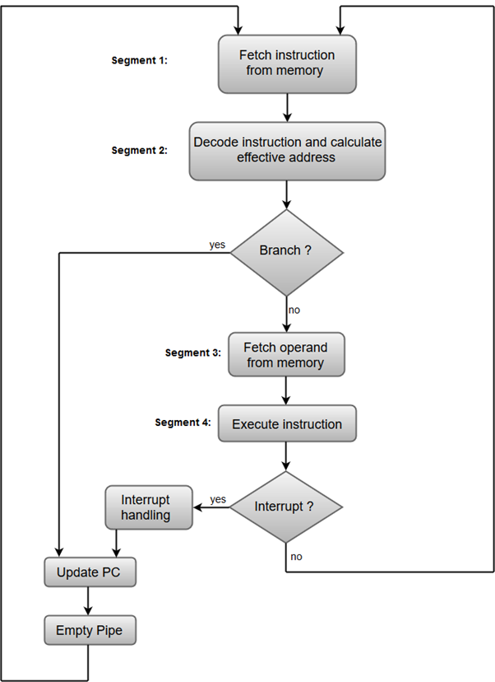

Slide 32
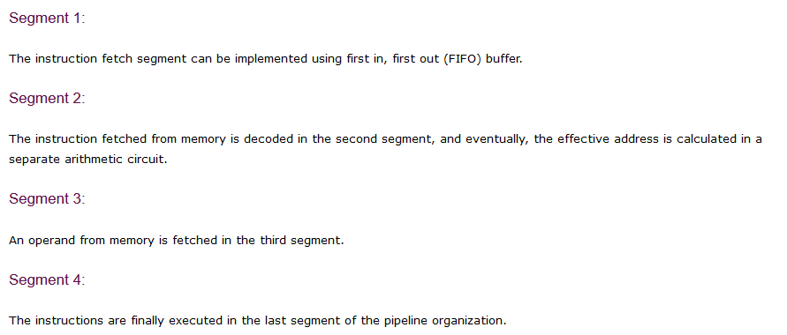

Slide 33
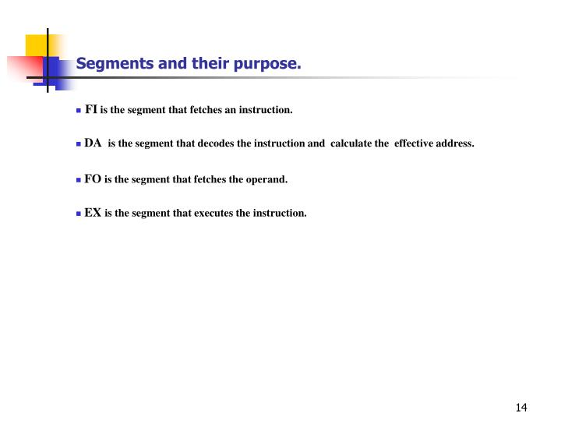

Slide 34
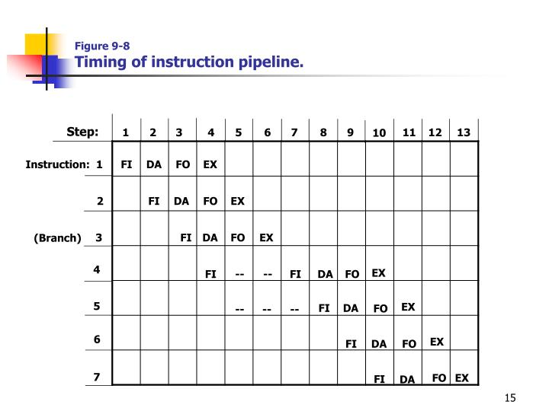

Slide 35
Pipeline conflicts
Resource Conflicts
Cause by access to memory by two segment at same time.
Resolve by using separate instruction and data memories.
Data dependency
Conflicts arise when and instruction depends on the result of previous instruction, but result is not yet available
Branch difficulties
Arise from branch and other instruction which change the value of PC

Slide 36
Data Dependency
Degradation of performance occurs in pipelining due to data collision and address collision.
Collision occurs when an instruction cant proceed because previous instructions didn’t not completed certain operations.
Data dependency occurs when an instruction needs data that are not yet available.
Address dependency may occurs when operand address cant be calculated because information needed by addressing mode is not available.

Slide 37
Data dependency conflict solution
Hardware interlocks:
Insert hardware locks
Interlock is circuit which detects instructions whose source operand are destination farther up in the pipeline.
Such instruction execution is delayed for enough clock cycles to resolve the conflict.
Operand Forwarding:
Uses special hardware to detect conflict.
Routes the Data through special path between pipelining segment
If such data is needed as source for other then they are feed to ALU directly without saving it to any register.

Slide 38
Delayed load:
Given responsibility to solve conflict to compiler
Simply delays the execution starting of instruction such that all data needed can successfully updated before execution
No operation instruction is inserted

Slide 39
RISC PIPELINE
Ability to use efficient instruction pipeline
Instruction have smaller number of sub operation which can execute in one clock pulse
Fixed format instruction so decoding is easy
All operand are in register so no need to calculate effective address
Can be executed in 2 or 3 segment.
Fetch instruction
Execute in ALU
Store ALU data into destination register

Slide 40
To resolve conflict of fetching instruction and loading or storing data, two separate buses are needed with two different memory for data and instruction
RISC single cycle instruction
Support given by compiler

Slide 41
Three segment instruction
I= instruction fetch
A=ALU operation
E=Execute instruction(write a register)

Slide 42
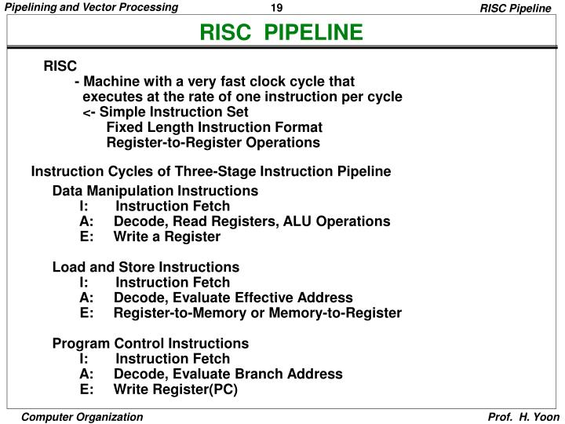

Slide 43
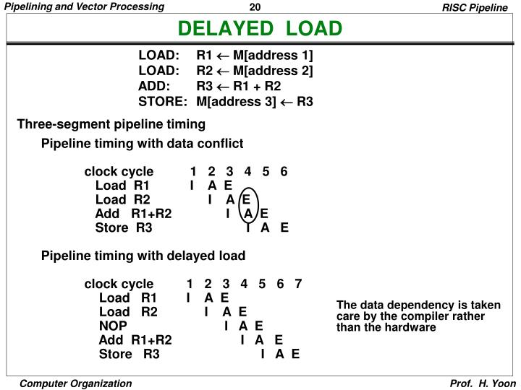

Slide 44
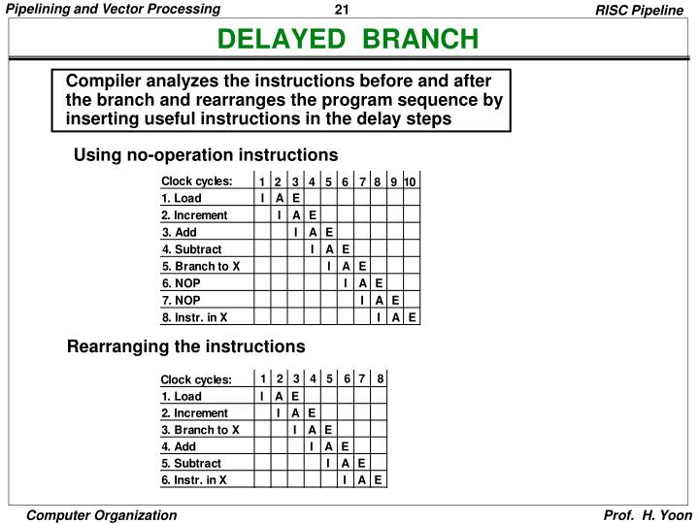

Slide 45
Handling branch instruction
Branch instruction can be conditional or unconditional
If unconditional it always break the sequence and load with target address
If conditional sequence of instruction execution is break only when condition is satisfied

Slide 46
Prefetch target instruction
Fetch target instruction in addition to the instruction following branch
Both are saved until branch is performed
Branch target buffer (BTB)
Is a associative memory included in the fetch segment of pipeline
Contains address of previously executed branch instruction and target instruction for that branch
Also stores the next few instructions after the branch target instruction

Slide 47
When the pipeline decodes branch instruction it search associative memory for the address of instruction.
If it is in BTB the it is prefetch otherwise pipeline shift to new instruction stream and stores the target instruction.

Slide 48
Loop buffer
Variation of BTB
Very small and high speed register file maintained by instruction fetch segment
When a program loop is detected in program it is store in the loop buffer including all branches.
Program loop can be executed without accessing memory until loop is removed by final branching out

Slide 49
Branch prediction:
Some computer uses branch prediction with some extra logic to guess outcome of conditional branch before it is executed.
Then pipeline begin to prefetch the instruction stream from predicted path.

Slide 50
Delayed Branch
This procedure is employed in RISC processor.
(EXPLAINED IN RISC PROCESSOR)

Slide 51
Vector processing
There are class of computing which are beyond the capabilities of conventional computer.
Such problem are formulated by vectors or array processing.

Slide 52
Application
Long range weather forecasting
Petroleum exploration
Seismic data analysis
Medical diagnosis
Aerodynamics and space flight simulation
AI and expert system
Mapping the human genome
Image processing

Slide 53
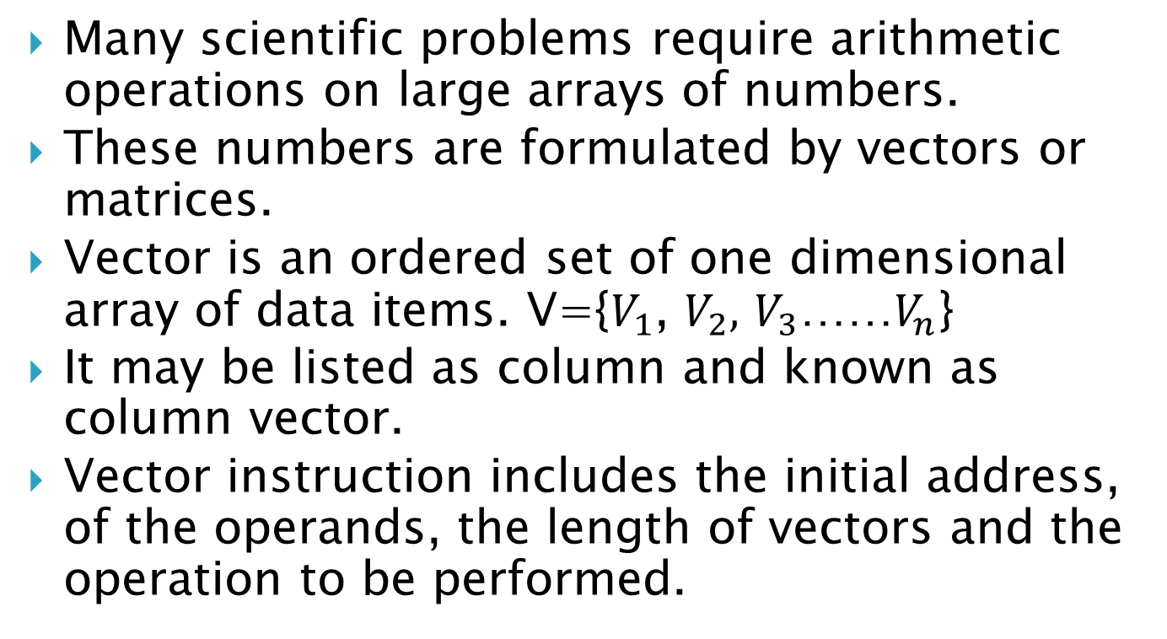
Vector Operations
Many scientific problems require arithmetic operations on large arrays of numbers.
These numbers are formulated by vectors or matrices.
Vector is an ordered set of one dimensional array of data items. V={$V_{1}$, $V_{2},$ $V_{3}$……$V_{n}$}
It may be listed as column and known as column vector.
Vector instruction includes the initial address, of the operands, the length of vectors and the operation to be performed.

Slide 54
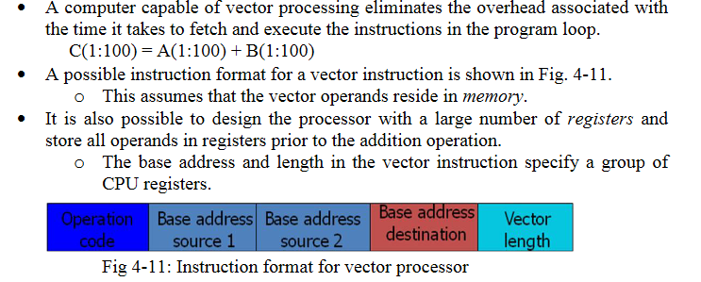

Slide 55
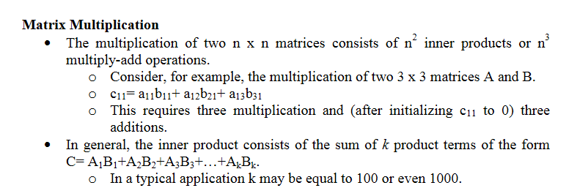
Matrix multiplication

Slide 56
